Slide 1

DIGITAL DESIGN AND COMPUTER ORGANIZATION
Assembly Language
Department of Computer Science and Engineering

Slide 2
DIGITAL DESIGN AND COMPUTER ORGANIZATION
Assembly Language T2:Ch2 2.6
Department of Computer Science and Engineering

Slide 3
Basic Structure of computers Outline
Assembly Languages
Assembly Language Syntax
Assembler Directives
Assembly and Execution of Programs
Number Notation
I/O Operations

Slide 4
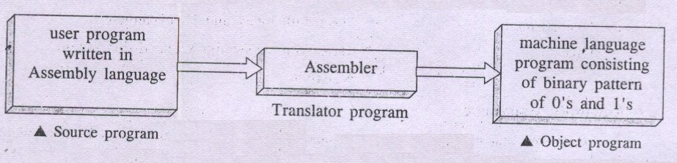
Machine Instructions and Programs Assembly Language
A complete set of such mnemonics, symbolic names for register & memory locations and a list of rules for their use forms a programming language called an Assembly Language.
The basic unit of assembly language program is a line of code.
Here every line of code has symbolic code called mnemonic opcode and symbolic name to represent address of memory location / register as the operand field.
The translator program is called an Assembler.
Carl Hamacher, Zvonko Vranesic, Safwat Zaky, Computer Organization, 5th ed., McGraw Hill, 2002, Section 2.6.1

Slide 5
Machine Instructions and Programs Assembly Language( T2 –section 2.6)
Here, symbolic codes are used to represent binary pattern of machine instructions. These symbolic codes are called as mnemonics.
Mnemonics are abbreviations that represent operation code(OP Code) of an instruction in a compact and meaningful symbolic form.
For instance mnemonics for few operation codes include:
INC / INR- Increment
ADDI - To add immediate operand
ADD - To add
LOAD - To load operand from memory
STORE- To store operand to memory
MOVE - To transfer data from one location to
another location/Register.
Carl Hamacher, Zvonko Vranesic, Safwat Zaky, Computer Organization, 5th ed., McGraw Hill, 2002, Section 2.6.1

Slide 6
Machine Instructions and Programs Assembly Language Syntax
For example, assembly language syntax suggests that a
move instruction to appear as follows:
MOVE R0, SUM
The opcode mnemonic MOVE is followed by at least one
blank space.
The source operand is in register R0 (register operand).
The destination operand is in the memory location SUM
For instance symbolic name of operand memory location
SUM suggest absolute mode or direct addressing mode
is used in the instruction.
Carl Hamacher, Zvonko Vranesic, Safwat Zaky, Computer Organization, 5th ed., McGraw Hill, 2002, Section 2.6.1

Slide 7

Machine Instructions and Programs Assembly Language Syntax
Sign # usually denotes an immediate operand in the instruction using Immediate Addressing mode
For example: ADD #10, R2 or ADDI 10, R2
MOVE #20, R3 or MOVEI 10,R2
Indirect addressing is usually specified by placing parentheses around the name or symbol
For example ADD (A), R0
Format of Assembly Language Statements
Carl Hamacher, Zvonko Vranesic, Safwat Zaky, Computer Organization, 5th ed., McGraw Hill, 2002, Section 2.6.1

Slide 8
Machine Instructions and Programs Assembler Directives
Assembler Directives are the assembler commands to the assembler concerning the program being assembled. These commands are neither translated into machine opcode nor assigned any memory location in the object program.
Thus an assembly language program is said to be a complete one and acceptable to an assembler for translation and for further assignment of memory locations – if it is associated with necessary assembler directives.
Examples of Assembler Directives:
S EQU 150
The assembler command EQU directs the assembler during translation that the symbolic name S must be replaced by value 150
Carl Hamacher, Zvonko Vranesic, Safwat Zaky, Computer Organization, 5th ed., McGraw Hill, 2002, Section 2.6.1

Slide 9
Machine Instructions and Programs Assembly Language
Memory arrangement for the program
100 Move N,R1
104 Move #NUM1,R2
108 Clear R0
112 Add (R2), R0
116 Add #4, R2
120 Decrement R1
124 Branch>0 LOOP
128 Move R0, SUM
Carl Hamacher, Zvonko Vranesic, Safwat Zaky, Computer Organization, 5th ed., McGraw Hill, 2002, Section 2.6.1

Slide 10
Machine Instructions and Programs Memory arrangement for the program
SUM 200
N 204
NUM1 208
NUM2 212
NUMn 604
608
100
. . .
Carl Hamacher, Zvonko Vranesic, Safwat Zaky, Computer Organization, 5th ed., McGraw Hill, 2002, Section 2.6.1

Slide 11
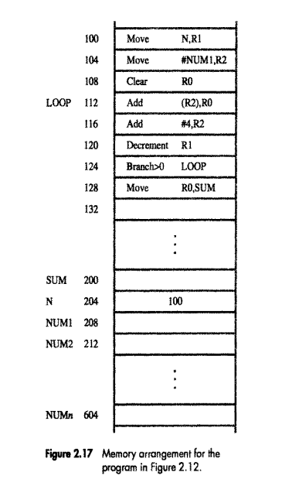
The machine instructions and the required data items are to be found after the program is loaded for execution. If the assembler is to produce an object program according to this arrangement, it has to know
How to interpret the names
Where to place the instructions in the memory
Where to place the data operands in the memory

Slide 12
Machine Instructions and Programs ALL representation for the program
SUM EQU 200
ORIGIN 204
N DATAWORD 100
NUM1 RESERVE 400
ORIGIN 100
START MOVE N,R1
MOVE #NUM1,R2
CLR R0
LOOP ADD (R2),R0
ADD #4,R2
DEC R1
BGTZ LOOP
MOVE R0,SUM
RETURN
END START
Carl Hamacher, Zvonko Vranesic, Safwat Zaky, Computer Organization, 5th ed., McGraw Hill, 2002, Section 2.6.1
Notes:
https://developer.arm.com/documentation/dui0473/m/directives-reference/equ#:~:text=The%20EQU%20directive%20gives%20a,or%20a%20PC%2Drelative%20value.

Slide 13
Machine Instructions and Programs Assembler Directives
ORIGIN 204
Instruct assembler to place data block at main memory locations starting from 204
N DATAWORD 100
Inform the assembler that value of N i.e. data value 100 is to be placed in the memory location 204.
ORIGIN 100
The second ORIGIN directive states that assembler directive must load machine instructions of the object program in the main memory starting from location 100.
Carl Hamacher, Zvonko Vranesic, Safwat Zaky, Computer Organization, 5th ed., McGraw Hill, 2002, Section 2.6.1

Slide 14
Machine Instructions and Programs Assembler Directives
NUM1 RESERVE 400
This directive declares that a memory block of 400 bytes is to be reserved for data, and that the name NUM1 is to be associated with address 208
Carl Hamacher, Zvonko Vranesic, Safwat Zaky, Computer Organization, 5th ed., McGraw Hill, 2002, Section 2.6.1

Slide 15
Machine Instructions and Programs Assembler Directives
RETURN
This is an assembler directive that identifies the point at which execution of the program should be terminated.
It causes the assembler to insert an appropriate machine instruction that returns control to the operating system of the computer.
Carl Hamacher, Zvonko Vranesic, Safwat Zaky, Computer Organization, 5th ed., McGraw Hill, 2002, Section 2.6.1

Slide 16
Machine Instructions and Programs Assembler Directives
END START
The last statement in the source program is the assembler directive END, which tells the assembler that this is the end of the source program text.
The END directive includes the label START, which is the address of the location at which execution of the program is to begin.
Carl Hamacher, Zvonko Vranesic, Safwat Zaky, Computer Organization, 5th ed., McGraw Hill, 2002, Section 2.6.1

Slide 17
Machine Instructions and Programs Assembler Directives
Label Operation Operand(s) Comment
These four fields are separated by an appropriate delimiter, typically one or more blank characters. The Label is an optional name associated with the memory address where the machine language instruction produced from the statement will be loaded. Labels may also be associated with addresses of data items. In Figure 2.18 there are five labels: SUM, N, NUM1, START, and LOOP.
The Operation field contains the OP-code mnemonic of the desired instruction or assembler directive. The Operand field contains addressing information for accessing one or more operands, depending on the type of instruction. The Comment field is ignored by the assembler program. It is used for documentation purposes to make the program easier to understand.

Slide 18
Machine Instructions and Programs Assembler Directives
How does an assembler directive differ from a regular instruction?
Unlike regular instructions, which are translated into machine code and executed by the CPU, assembler directives are not converted into machine opcodes and are not assigned any memory location in the object program. They are essentially instructions to the assembler itself, rather than to the computer's processor.
Carl Hamacher, Zvonko Vranesic, Safwat Zaky, Computer Organization, 5th ed., McGraw Hill, 2002, Section 2.6.1

Slide 19
Machine Instructions and Programs ASSEMBLY AND EXECUTION OF PROGRAMS
What steps are involved in the assembly and execution of programs, and why might these steps be crucial for efficient program operation?
Carl Hamacher, Zvonko Vranesic, Safwat Zaky, Computer Organization, 5th ed., McGraw Hill, 2002, Section 2.6.2

Slide 20
Machine Instructions and Programs ASSEMBLY AND EXECUTION OF PROGRAMS
A source program written in an assembly language must be assembled into a machine language object program before it can be executed -performed by assembler.
As the assembler scans through a source programs, it keeps track of all names and the numerical values that correspond to them in a symbol table .
Carl Hamacher, Zvonko Vranesic, Safwat Zaky, Computer Organization, 5th ed., McGraw Hill, 2002, Section 2.6.2

Slide 21
Machine Instructions and Programs ASSEMBLY AND EXECUTION OF PROGRAMS
When a name appears a second time, it is replaced with its value from the table .
A problem arises when a name appears as an operand before it is given a value. For example, this happens if a forward branch is required.
A simple solution to this problem is to have the assembler scan through the source program twice.
During the first pass, it creates a complete symbol table. At the end of this pass, all names will have been assigned numerical values.
The assembler then goes through the source program a second time and substitutes values for all names from the symbol table. Such an assembler is called a two-pass assembler.
Carl Hamacher, Zvonko Vranesic, Safwat Zaky, Computer Organization, 5th ed., McGraw Hill, 2002, Section 2.6.2

Slide 22
Machine Instructions and Programs ASSEMBLY AND EXECUTION OF PROGRAMS
The assembler stores the object program on a magnetic disk.
The object program must be loaded into the memory of the computer before it is executed.
This task is performed by an utility program called a loader.
Assembler can detect syntax errors
Carl Hamacher, Zvonko Vranesic, Safwat Zaky, Computer Organization, 5th ed., McGraw Hill, 2002, Section 2.6.2

Slide 23
Machine Instructions and Programs ASSEMBLY AND EXECUTION OF PROGRAMS
The loader must know the length of the program and the address in the memory where it will be stored.
The assembler usually places this information in a header preceding the object code.
Having loaded the object code, the loader starts execution of the object program by branching to the first instruction to be executed.
The address of this instruction has been included in the assembly language program as the operand of the END assembler directive. The assembler includes this address in the header that precedes the object code on the disk.
Errors are found in program using debugger program
Carl Hamacher, Zvonko Vranesic, Safwat Zaky, Computer Organization, 5th ed., McGraw Hill, 2002, Section 2.6.2

Slide 24
Machine Instructions and Programs NUMBER NOTATION
ADD #93, R1
or
ADD #%01011101, R1
or
ADD #$5D, R1
Carl Hamacher, Zvonko Vranesic, Safwat Zaky, Computer Organization, 5th ed., McGraw Hill, 2002, Section 2.6.3

Slide 25
DIGITAL DESIGN AND COMPUTER ORGANIZATION
I/O Operations
Department of Computer Science and Engineering

Slide 26
Machine Instructions and Programs BASIC INPUT/OUTPUT OPERATIONS (T2 section 2.7)
How is the interaction between the central processing unit (CPU) and input/output (I/O) devices is managed in terms of data transfer and control?
Carl Hamacher, Zvonko Vranesic, Safwat Zaky, Computer Organization, 5th ed., McGraw Hill, 2002, Section 2.7

Slide 27
Machine Instructions and Programs BASIC INPUT/OUTPUT OPERATIONS
Program Controlled I/O refers to a method of input/output (I/O) operation in which the CPU is directly responsible for managing the transfer of data between peripherals (like keyboards, displays, or sensors) and memory.
Processor and I/O requires a synchronization mechanism because of the difference in speed.
A solution to this problem is as follows: On output, the processor sends the first character and then waits for a signal from the display that the character has been received. It then sends the second character, and so on. Input is sent from the keyboard in a similar way; the processor waits for a signal indicating that a character key has been struck and that its code is available in some buffer register associated with the keyboard. Then the processor proceeds to read that code.
Carl Hamacher, Zvonko Vranesic, Safwat Zaky, Computer Organization, 5th ed., McGraw Hill, 2002, Section 2.7

Slide 28
Machine Instructions and Programs BASIC INPUT/OUTPUT OPERATIONS
Mechanism of I/O transfer
between processor and keyboard & video monitor:
A character key when pressed from the keyboard its scan code is sent to an 8-bit buffer register DATAIN in the keyboard.
Processor is informed about a valid character data presence in DATAIN register by setting a synchronization flag SIN to 1.
I/O driver program continuously monitors contents of SIN flag, & when SIN is set to 1, it reads the contents of DATAIN.
Thus character stored in DATAIN register is transferred to processor over a system bus and SIN content is automatically reset to 0.
Carl Hamacher, Zvonko Vranesic, Safwat Zaky, Computer Organization, 5th ed., McGraw Hill, 2002, Section 2.7

Slide 29
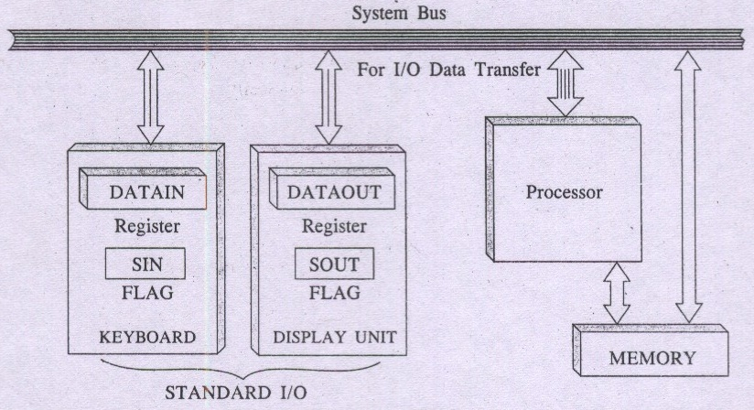
Machine Instructions and Programs ASSEMBLY AND EXECUTION OF PROGRAMS
Mechanism of I/O transfer
between Processor and Keyboard & Video monitor
Carl Hamacher, Zvonko Vranesic, Safwat Zaky, Computer Organization, 5th ed., McGraw Hill, 2002, Section 2.7

Slide 30
Machine Instructions and Programs ASSEMBLY AND EXECUTION OF PROGRAMS
A similar set of events take place while transferring a character data from processor to the display screen.
Here a DATAOUT register that holds a character’s code to be displayed when synchronization control flag SOUT is set to 1. When SOUT equals 1, the display device is ready to receive a character from processor.
The transfer of a character to DATAOUT resets SOUT to 0.
I/O driver program instructions control the status of SOUT flag.
👉The buffer registers DATAIN, DATAOUT, and control flags SIN, SOUT in this hardware setup forms parts of a connectivity circuits commonly known as device interface or interface hardware.
Carl Hamacher, Zvonko Vranesic, Safwat Zaky, Computer Organization, 5th ed., McGraw Hill, 2002, Section 2.7

Slide 31

Machine Instructions and Programs ASSEMBLY AND EXECUTION OF PROGRAMS
I/O driver program instructions for I/O data transfer
WRITEWAIT Branch to WRITEWAIT if SOUT = 0
Output from R0 to DATAOUT (if SOUT = 1)
SOUT is set to 1 when display terminal is free to display next
character.
The wait loop is executed repeatedly until the control flag
SOUT is set to 1 by the display terminal.
Initial state of SIN is 0 and SOUT is 1
Carl Hamacher, Zvonko Vranesic, Safwat Zaky, Computer Organization, 5th ed., McGraw Hill, 2002, Section 2.7

Slide 32
Machine Instructions and Programs ASSEMBLY AND EXECUTION OF PROGRAMS
Memory mapped i/o – some memory addresses refer to peripheral device buffer registers, such as DATAIN,DATAOUT
Data can be transferred b/w the cpu and these registers using same set of instructions and same status flags
Ex: MoveByte DATAIN,R0
MoveByte R0,DATAOUT
Status flags SIN and SOUT can be included device status register
Assume that the bit b₃ of the status registers INSTATUS,OUTSTATUS corresponds to SIN and SOUT
Carl Hamacher, Zvonko Vranesic, Safwat Zaky, Computer Organization, 5th ed., McGraw Hill, 2002, Section 2.7
Notes:
Memory-mapped I/O uses the same address space to address both main memory and I/O devices
I/O-mapped I/O assigns separate scope with areas for enter and output operations

Slide 33
Machine Instructions and Programs ASSEMBLY AND EXECUTION OF PROGRAMS
Then read and write operation can be implemented as:
READWAIT TestBit #3,INSTATUS
Branch=0 READWAIT
MoveByte DATAIN,R0
WRITEWAIT TestBit #3,OUTSTATUS
Branch=0 WRITEWAIT
MoveByte R0,DATAOUT
Carl Hamacher, Zvonko Vranesic, Safwat Zaky, Computer Organization, 5th ed., McGraw Hill, 2002, Section 2.7

Slide 34
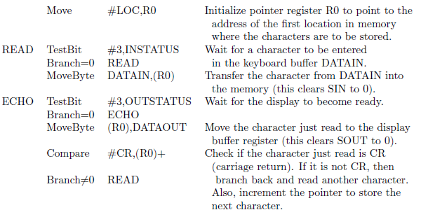
Machine Instructions and Programs ASSEMBLY AND EXECUTION OF PROGRAMS
Program to read a line of chars and to display it
Carl Hamacher, Zvonko Vranesic, Safwat Zaky, Computer Organization, 5th ed., McGraw Hill, 2002, Section 2.7
Notes:
The carriage return (CR) character is a control character in computing, used to reset the position of the cursor to the beginning of the current line without advancing to the next line.

Slide 35
Machine Instructions and Programs MCQ
In Program Controlled I/O, which synchronization flag is set to 1 when a key is pressed on the keyboard?
a) SOUT b) DATAIN c) SIN d) DATAOUT
The END directive in an Assembly program is used to:
a) Terminate program execution b) Mark end of source program text c) Generate an unconditional jump d) Indicate the return address
Carl Hamacher, Zvonko Vranesic, Safwat Zaky, Computer Organization, 5th ed., McGraw Hill, 2002, Section 2.7

Slide 36
Machine Instructions and Programs MCQ
In Program Controlled I/O, which synchronization flag is set to 1 when a key is pressed on the keyboard?
a) SOUT b) DATAIN c) SIN d) DATAOUT
Answer: c) SIN
The END directive in an Assembly program is used to:
a) Terminate program execution b) Mark end of source program text c) Generate an unconditional jump d) Indicate the return address
Answer: b) Mark end of source program text
Carl Hamacher, Zvonko Vranesic, Safwat Zaky, Computer Organization, 5th ed., McGraw Hill, 2002, Section 2.7

Slide 37
Machine Instructions and Programs MCQ
Which one of the following is an assembler directive and not a machine instruction?
a) MOVE b) ADD c) ORIGIN d) LOAD
Answer: c) ORIGIN
Carl Hamacher, Zvonko Vranesic, Safwat Zaky, Computer Organization, 5th ed., McGraw Hill, 2002, Section 2.7

Slide 38
Machine Instructions and Programs MCQ
Which one of the following is an assembler directive and not a machine instruction?
MOVE
ADD
ORIGIN
LOAD
A two-pass assembler is required mainly because:
a) It must scan the program twice to detect all errors b) Forward references to labels cannot be resolved in a single pass c) Directives must be placed before instructions d) Loader requires two passes for relocation

Slide 39
Machine Instructions and Programs MCQ
Which one of the following is an assembler directive and not a machine instruction?
MOVE
ADD
ORIGIN
LOAD
Ans: Origin
A two-pass assembler is required mainly because:
a) It must scan the program twice to detect all errors b) Forward references to labels cannot be resolved in a single pass c) Directives must be placed before instructions d) Loader requires two passes for relocation
Answer: b) Forward references to labels cannot be resolved in a single pass

Slide 40
THANK YOU
Team DDCO
Department of Computer Science

